Slide 1
Optimization Strategy
Data Warehouse and OLAP

Slide 2
Learning Outcomes
By the end of this lecture, YOU should be able to:
Explain data warehouse and OLAP concepts
Explain the data warehouse architecture and schemes
Introduce the concept of OLAP

Slide 3
Key Terms you must be able to use
If you have mastered this topic, you should be able to use the following terms correctly in your assignments and exams:
  OLTP
  OLAP
  Data Cube
  Star Scheme

Slide 4
Data Warehousing and OLAP
What is a data warehouse?
A multi-dimensional data model

Slide 5
What is Data Warehouse?
Defined in many different ways, but not strictly.
  A decision support database that is maintained separately from the organization’s operational database
  Support information processing by providing a solid platform of consolidated, historical data for analysis.
“A data warehouse is a subject-oriented, integrated, time-variant, and nonvolatile collection of data in support of management’s decision-making process.”—W. H. Inmon
Data warehousing:
  The process of constructing and using data warehouses
Notes:
“Then, what exactly is a data warehouse?” Data warehouses have been deﬁned in many
ways, making it difﬁcult to formulate a rigorous deﬁnition. Loosely speaking, a data
warehouse refers to a database that is maintained separately from an organization’s oper-
ational databases. Data warehouse systems allow for the integration of a variety of appli-
cation systems. They support information processing by providing a solid platform of
consolidated historical data for analysis.
In sum, a data warehouse is a semantically consistent data store that serves as a phys-
ical implementation of a decision support data model and stores the information on
which an enterprise needs to make strategic decisions. A data warehouse is also often
viewed as an architecture, constructed by integrating data from multiple heterogeneous
sources to support structured and/or ad hoc queries, analytical reporting, and decision
making.

Slide 6
Data Warehouse—Subject-Oriented
Organized around major subjects, such as customer, product, sales.
Focusing on the modeling and analysis of data for decision makers, not on daily operations or transaction processing.
Provide a simple and concise view around particular subject issues by excluding data that are not useful in the decision support process.

Slide 7
Data Warehouse—Integrated
Constructed by integrating multiple, heterogeneous data sources
  relational databases, flat files, on-line transaction records
Data cleaning and data integration techniques are applied.
  Ensure consistency in naming conventions, encoding structures, attribute measures, etc. among different data sources
    E.g., Hotel price: currency, tax, breakfast covered, etc.
  When data is moved to the warehouse, it is converted.

Slide 8
Data Warehouse—Time Variant
The time horizon for the data warehouse is significantly longer than that of operational systems.
  Operational database: current value data.
  Data warehouse data: provide information from a historical perspective (e.g., past 5-10 years)
Every key structure in the data warehouse
  Contains an element of time, explicitly or implicitly
  But the key of operational data may or may not contain “time element”.

Slide 9
Data Warehouse—Non-Volatile
A physically separate store of data transformed from the operational environment.
Operational update of data does not occur in the data warehouse environment.
  Does not require transaction processing, recovery, and concurrency control mechanisms
  Requires only two operations in data accessing:
    initial loading of data and access of data.

Slide 10
How are organizations using the information from data warehouses ?
Many organizations use this information to support business decision making activities:
Increasing customer focus, which includes the analysis of customer buying patterns (such as buying preference, buying time, budget cycles, and appetites for spending).
Repositioning products and managing product portfolios by comparing the performance of sales by quarter, by year, and by geographic regions in order to ﬁne-tune production strategies.

Slide 11
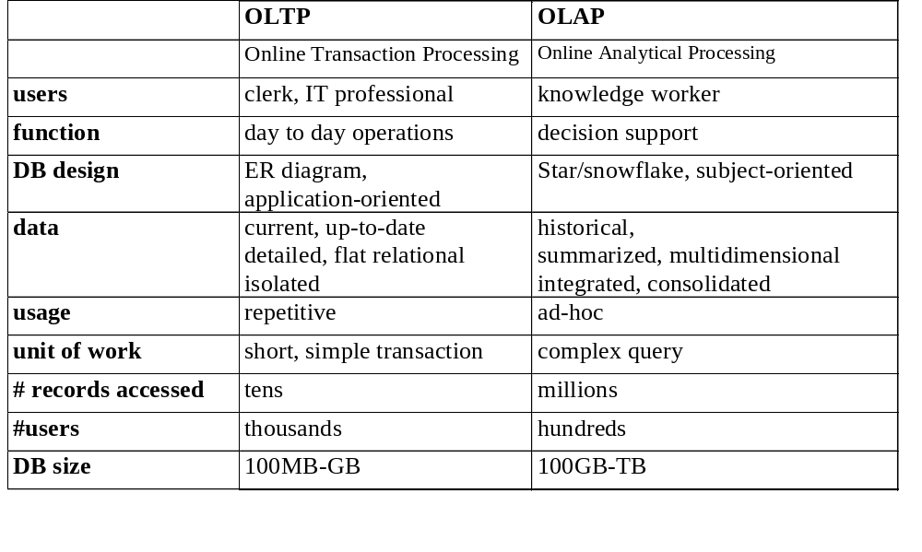
OLTP vs. OLAP

Slide 12
Why Separate Data Warehouse?
High performance for both systems
  DBMS— tuned for OLTP: access methods, indexing, concurrency control, recovery
  Warehouse—tuned for OLAP: complex OLAP queries, multidimensional view, consolidation.
Different functions and different data:
  missing data: Decision support requires historical data which operational DBs do not typically maintain
  data consolidation: DS requires consolidation (aggregation, summarization) of data from heterogeneous sources
  data quality: different sources typically use inconsistent data representations, codes and formats which have to be reconciled

Slide 13
Data Warehousing and OLAP
What is a data warehouse?
A multi-dimensional data model
Data warehouse architecture

Slide 14
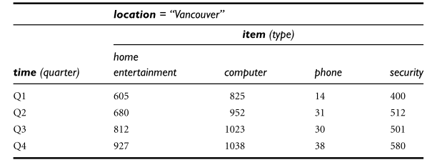
A 2-D view of sales data for AllElectronics
Notes:
A 2-D view of sales data for AllElectronics according to the dimensions time and item,
where the sales are from branches located in the city of Vancouver. The measure dis-
played is dollars sold (in thousands).

Slide 15
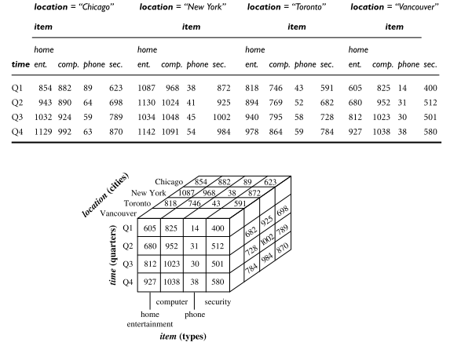
3-D view of sales data for AllElectronics
Notes:
Now, suppose that we would like to view the sales data with a third dimension. For
instance, suppose we would like to view the data according to time and item, as well as
location for the cities Chicago, New York, Toronto, and Vancouver.

Slide 16
From Tables and Spreadsheets to Data Cubes
A data warehouse is based on a multidimensional data model which views data in the form of a data cube
A data cube, such as sales, allows data to be modeled and viewed in multiple dimensions
  Dimension tables, such as item (item_name, brand, type), or time(day, week, month, quarter, year)
  Fact table contains measures (such as dollars_sold) and keys to each of the related dimension tables
In data warehousing literature, an n-D base cube is called a base cuboid. The top most 0-D cuboid, which holds the highest-level of summarization, is called the apex cuboid. The lattice of cuboids forms a data cube.

Slide 17
Conceptual Modeling of Data Warehouses
Modeling data warehouses: dimensions & measures
  Star schema: A fact table in the middle connected to a set of dimension tables
  Snowflake schema: A refinement of star schema where some dimensional hierarchy is normalized into a set of smaller dimension tables, forming a shape similar to snowflake
  Fact constellations: Multiple fact tables share dimension tables, viewed as a collection of stars, therefore called galaxy schema or fact constellation

Slide 18
Star schema
The most common modeling paradigm is the star schema, in which the data warehouse contains :
(1) a large central table (fact table) containing the bulk of the data, with no redundancy, and
(2) a set of smaller attendant tables (dimension tables), one for each dimension. The schema graph resembles a starburst, with the dimension tables displayed in a radial pattern around the central fact table.

Slide 19
Example of Star Schema
time
time_key
day
day_of_the_week
month
quarter
year
item
item_key
item_name
brand
type
supplier_type
Sales Fact Table
time_key
item_key
branch_key
branch
location
location_key
branch_key
branch_name
branch_type
location_key
street
city
province_or_street
country
units_sold
dollars_sold
avg_sales
Measures

Slide 20
Q & A

